Slide 1
the iconic
Digital Time Capsule Project
mission…no senior left behind!

Slide 2
digital time capsule (noun)
Definition of digital time capsule: a collection of images gathered to capture an era and to be reopened at a later date; representative of current culture that is saved and remembered at a specific time in the future.
THE CLASS THAT MADE HISTORY!
CLASS OF 2020

Slide 3
In addition to creating a digital time capsule…here are a few ways the project can support our graduating seniors right now!
Digital keepsake for every senior!
Dedicated slide for every senior! No senior left behind!
Personal touch in keeping with our Westside vision!
An EOY activity to keep seniors engaged!
Readily available for future celebratory activities honoring the Class of 2020!
Compliment to Virtual Graduation Ceremony
CHOICE!
Senior will choose images that reflect what they personally value!

Slide 4
NOW WHAT?
Check out the next slides…
Example
Capsule Layouts
Seniors create their own!
Seniors, or parent, upload one page

Slide 5
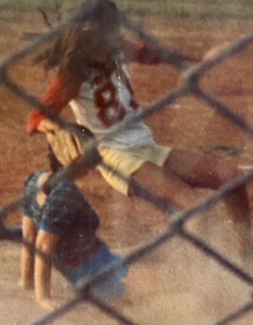
Example
Senior Name: Marguerite Stewart

Slide 6
Capsule #1
PHOTO that represents your passion, values, or a moment you cherish
PHOTO
Senior life, extracurricular, club, service
SENIOR PORTRAIT
PHOTO that represents your future goals, college, or career
Senior Name:

Slide 7
Capsule #2
Senior Name:

Slide 8
Capsule #3
Senior Name: Chappell

Slide 9
Capsule #4
Senior Name:

Slide 10
Capsule #5
Senior Name:

Slide 11
Capsule #6
Senior Name:

Slide 12
DRAG AND DROP PHOTO INSTRUCTIONS
Step 1:
Select 2-4 Photos
1. Senior Portrait or Photo (Req)
2. Photo that captures your passion, values, or Covid-19 experience (Req)
3. Senior Life/Activity (optional)
4. Senior Life/Future Goal (optional)
Step 2:
Drag and Drop
Choose layout for the number of photos you want to include!
Drag and drop your photos into the template!
Step 3:
Submit by May 31st!
Name File:
STU ID# _LastName_Dean
452332_Joseph_Pliskin
Upload Time Capsule: https://bit.ly/2WUb3yb
Due to time constraints, changes cannot be made after submission; likewise, inappropriate material will result in the entire senior page being deleted.

